Slide 1
Employee Data Analysis using Excel
STUDENT NAME: D.PAVITHRA
REGISTER NO: 312200263
DEPARTMENT: B.com ACCOUNTING&FINANCE(3RD YEAR)
COLLEGE: S.I.V.E.T COLLEGE
NAAN MUDHALVAN : asunm103unm103312200263/ 109243D12065099AD6E472E7363332BB

Slide 2
PROJECT TITLE
Employee Performance Analysis using Excel

Slide 3


AGENDA
Problem Statement
Project Overview
End Users
Our Solution and Proposition
Dataset Description
Modelling Approach
Results and Discussion
Conclusion
3/21/2024 Annual Review

Slide 4

PROBLEM STATEMENT
"Given a dataset containing employee information, including salary,
the objective is to analyze the data to identify trends, disparities, and key
factors influencing employee compensation. The goal is to provide
actionable insights that can help in optimizing salary structures, ensuring
fair compensation practices, and supporting strategic decision-making
in HR management."

Slide 5

PROJECT OVERVIEW
.
The objective of this project is to organize, analyze, and visualize employee data, including salary details, to support decision-making processes regarding compensation, workforce planning, and performance management

Slide 6

WHO ARE THE END USERS?
Human Resource (HR) Department
Finance Department
Top Management and Executives
Department Management and Supervisors
Auditors (Internal & External)
Employees (Limited Access)

Slide 7

OUR SOLUTION AND ITS VALUE PROPOSITION
OUR SOLUTION :
Our solution provides a comprehensive Excel-based tool
for managing and analyzing employee salary data. It is
designed to streamline payroll processes, ensure data
accuracy, and enhance strategic decision-making.
VALUE PROPOSITION :
Efficiency and time savings
Cost effective solution
Data driven decision making
Enhanced transparency and compliance
Improved employee satisfaction

Slide 8
Dataset Description
When describing employee salary data in an Excel sheet, it’s important to provide clear labels and consistent formatting to make the data easy to understand and analyze. Here’s a typical structure and description of what each column might represent:
Employee ID
Description: A unique identifier assigned to each employee.
Name
Description: The first name of the employee.
Department
Description: The department where the employee works.
Salary
Description: The annual salary of the employee.
Gender
Description: The gender of the employee (if applicable).
Location
Description: The geographical location where the employee is based.

Slide 9

THE "WOW" IN OUR SOLUTION
Conditional Formatting
Visual cues like color coding to highlight key metrics, anomalies, or critical issues, such as employees nearing salary caps.
Tools: Conditional Formatting
Wow Factor: Makes it easy to spot trends and outliers at a glance
3/21/2024 Annual Review
9

Slide 10
MODELLING
Pie Charts:
To show the proportion of total compensation across different departments or roles.
Conditional Formatting:
Apply conditional formatting to highlight certain salary ranges or discrepancies.
Pivot Table:
1) Go to Insert > PivotTable.
2 )Choose the data range and where you want the PivotTable to be placed.
3 )Drag fields into Rows, Columns, and Values areas to analyze data.
10

Slide 11
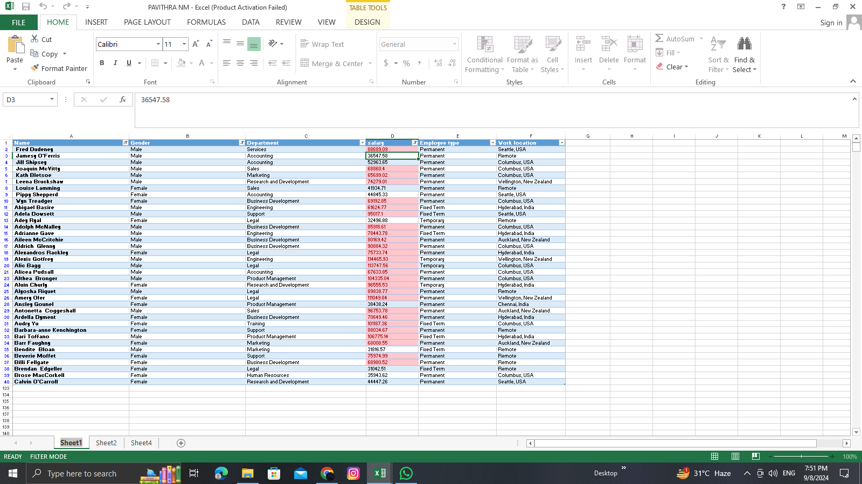
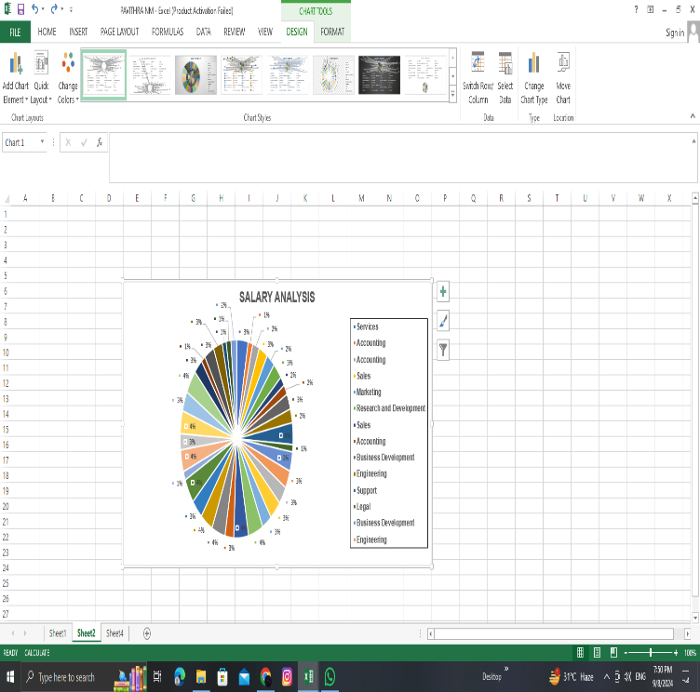
RESULTS
11

Slide 12
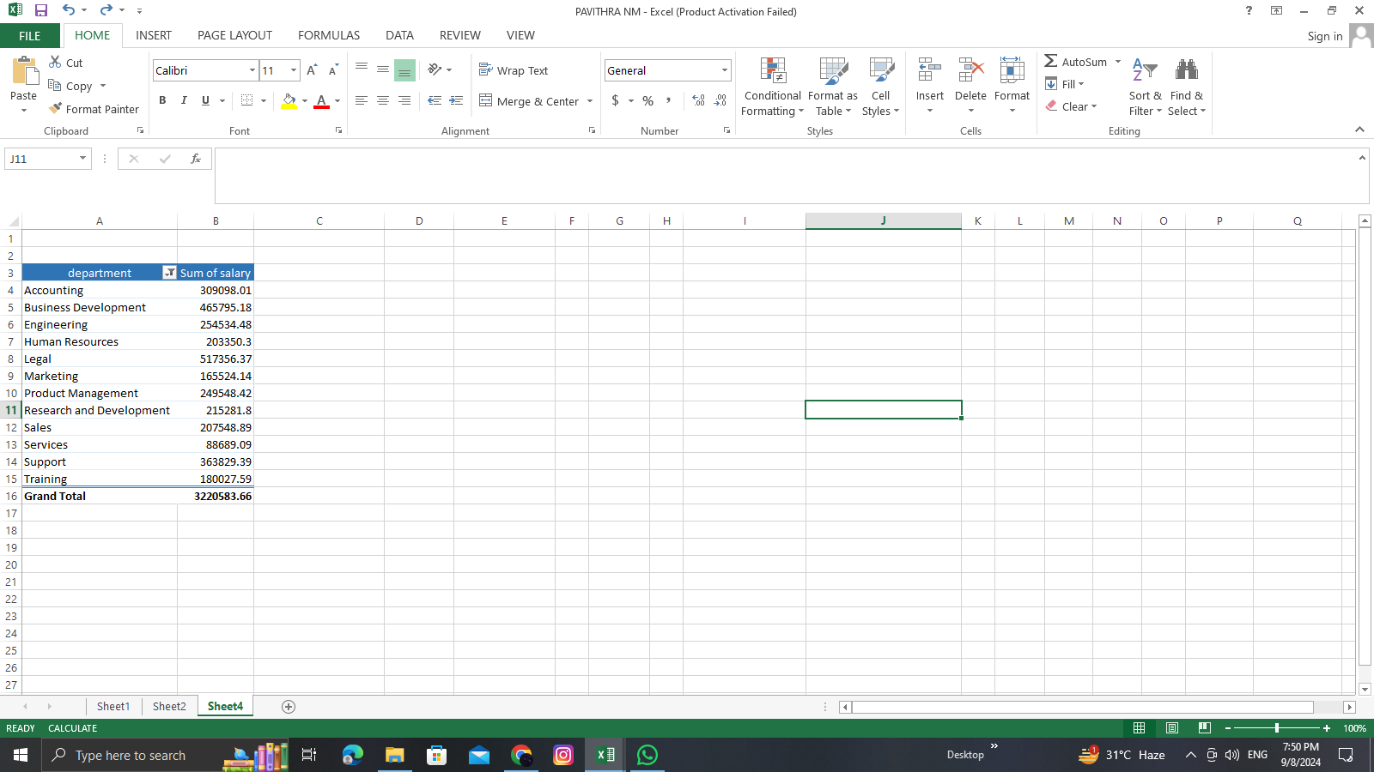

Slide 13
conclusion
Using Excel tools for analyzing employee salary data provides a clear overview of compensation patterns and discrepancies. Features such as PivotTables, charts, and conditional formatting help in summarizing, visualizing, and identifying trends or outliers effectively, leading to informed decision-making.

